Slide 1
Fake News Detection
Batch no. 2
Guide Name: P. Siva Prasad, M.Tech
Asst. Professor

Slide 2
Contents
Introduction
Product Perspective
Operating Environment
System Features (One System feature per slide)
Software Quality Attributes
Analysis Models (USECASE Diagram, CLASSES, Sequence Diagram)

Slide 3
Introduction
Fake news is news or stories created to deliberately misinform or deceive readers. It often has the aim of damaging the reputation of a person or entity, or making money through advertising revenue.
This is generally done to further or impose certain ideas and is often achieved with political agendas. Minimization of such news is necessary. So, the purpose of the project is to notify users about the genuineness of the news, whether it is real or fake.
There are already some websites which identify fake news and write about them and there are websites which can identify if it is fake news when you enter the news article title.
This is often limited, because websites write only about fake news in specific regions, which makes them difficult to identify and verify. And, also most people won’t visit another site to verify something.
The scope of the project is to automate all this process. It automatically reads text from web page containing news articles and verifies it in the background without redirecting to any other page and then notifies the user whether it is fake or not. This makes it easy for the user as well. Our project also accepts feedback from the users.

Slide 4
Product Perspective
Analyzing and detecting fake news is an arbitrary problem to be solved. Recently, Fake News had been an important talk in public and researchers due to online media outlets like social media feeds, blogs, and online newspaper.
To minimize the effects of such news, we must verify news. Purpose of the project is to detect fake news.
The proposed fake news detection helps to notify the user that the article they have read on a website is real or fake using browser extension with Machine learning model working in the back ground.

Slide 5
Operating Environment
A browser extension is a small software application that adds a capacity or functionality to a web browser. The operating environment for the software is a web browser.

Slide 6
Feature 1: Verification of News
Description and Priority
Data extracted from the news article on the web page is subject to the ML model.
Verification of news is done with the help of a Machine Learning model in the background which uses three widely used machine learning methods: Naive Bayes Classifier, Passive Aggressive Classifier and TFIDF Vectorizer.
This is a classic text classification problem with a straightforward proposition. This feature has the highest priority.
Stimulus/Response Sequences
When a user opens the web page to read a news article, processing the news article is done in background and a popup window will display as a response.
There are no other sequences because all the process is automated and runs in the background.
Functional Requirements
A web extension has to be added to the web browser.
Detection fake news has to be done and inform the user about it.
A genuinity meter has to be used to inform the user about the genuineness of the news.

Slide 7
Feature 2: FeedBack
Description and Priority
The user can inform us about the accuracy of the results if they are aware about the genuinity of the article.
This Feedback helps us to improvise our training dataset and accuracy rates.
Stimulus/Response Sequences
User provides their feedback in the Feedback column (If they want to).
Response to that is a massage will be displayed, thanking the user for the feedback submitted.
Functional Requirements
Comments or feedback from the user.
A pop-up window for the feedback form.
Displaying the message after user had submitted the feedback form.

Slide 8
Software Quality Attributes
Accuracy: Accuracy is the degree of closeness to the true value. Confusion matrix and Accuracy score are used as metrics for calculating accuracy.

Slide 9
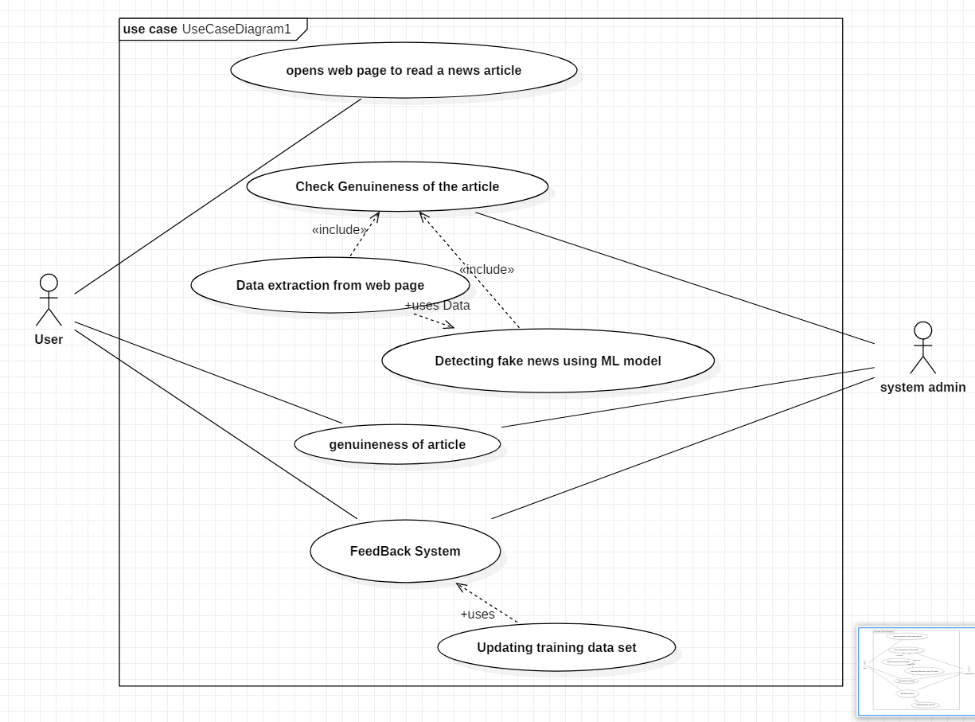
USECASE Diagram

Slide 10
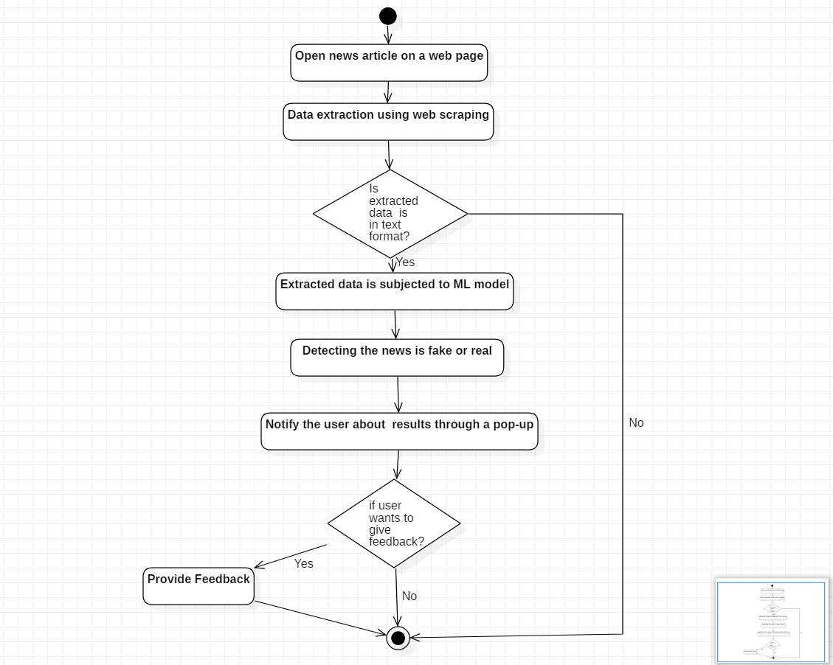
Activity diagram

Slide 11
Questions?

